Slide 1
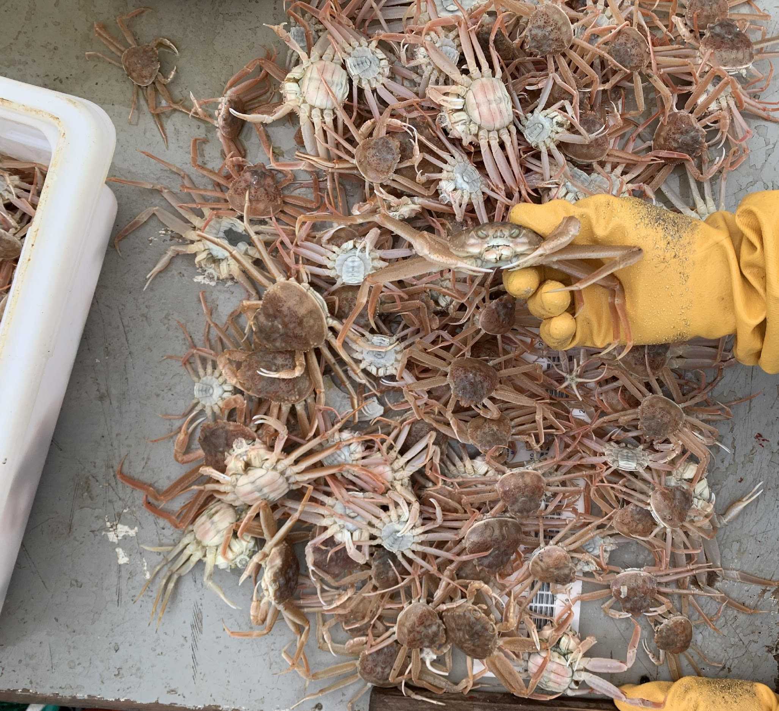


Bering Sea snow crab health indicators
Erin Fedewa
NOAA Alaska Fisheries Science Center
Collaborators: Louise Copeman, Mike Litzow, Hamish Small, Kim Ledger, and Jon Richar

Slide 2

Energetic Condition
Health Indicators
Natural Mortality
Size at Maturity
Disease Prevalence
Recruitment
Reproductive Potential
Clutch Fullness
Notes:
Primarily focusing on energetic condition and disease, due to their potential mechanistic links to the bering sea snow crab mortality event – and they are processes both thought be driven by temperature and density dependent processes

Slide 3
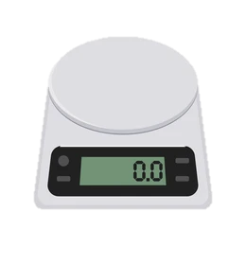

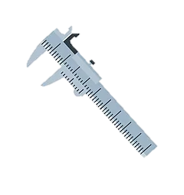
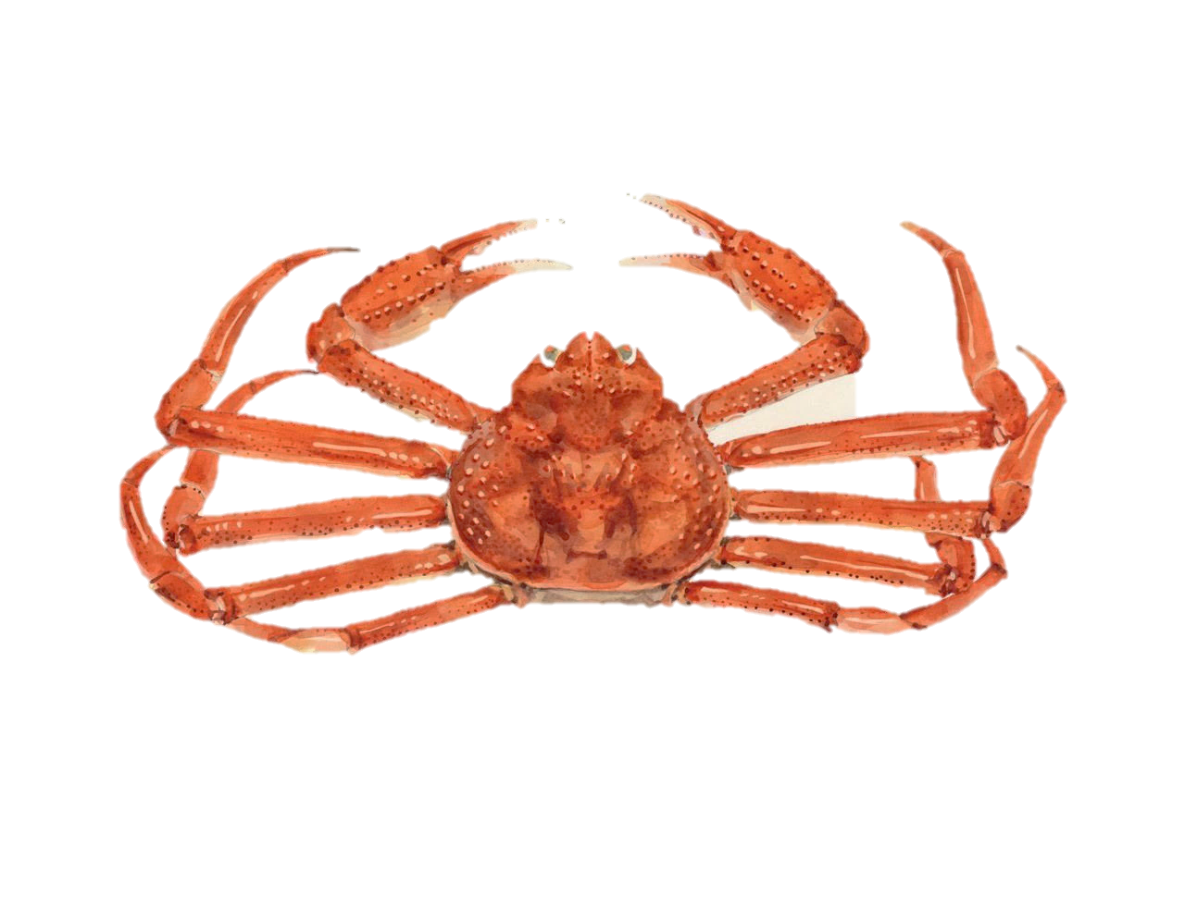
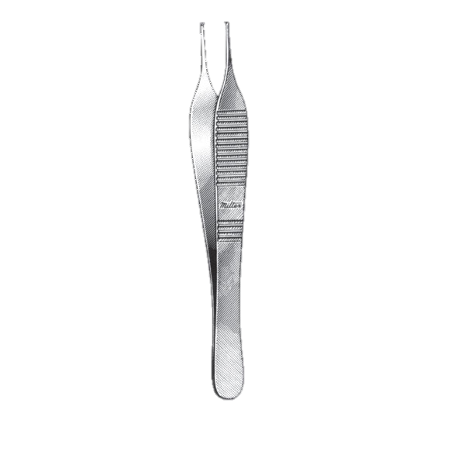
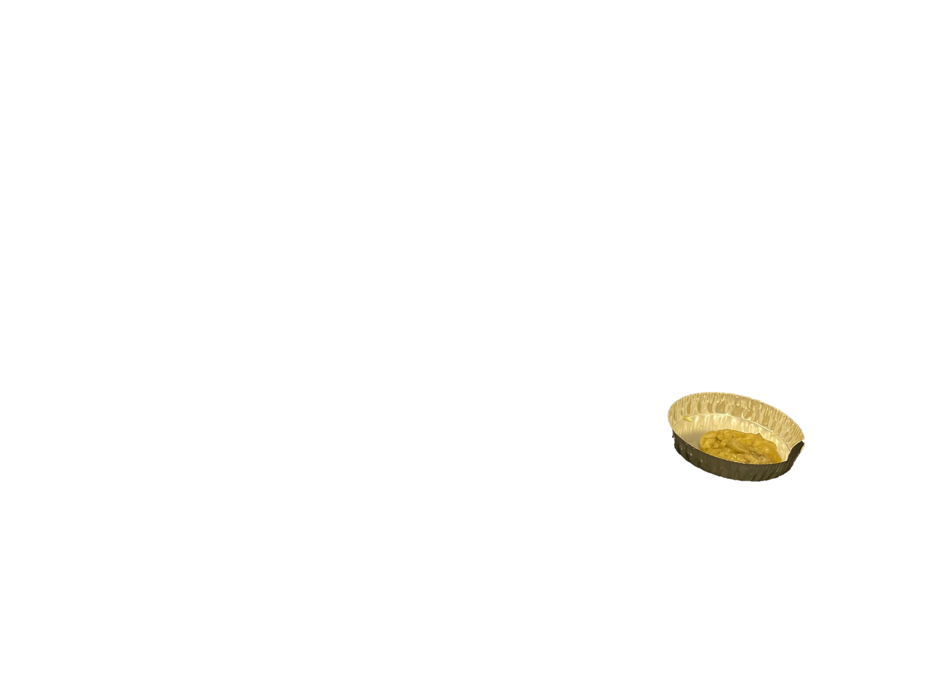
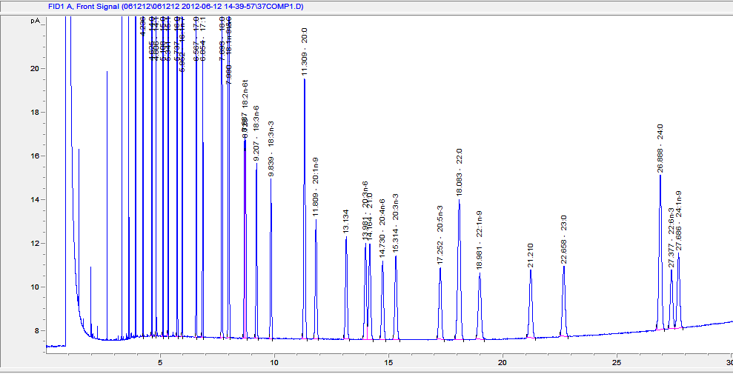

Energetic Condition
Many metrics for assessing condition in snow crab are insensitive, or have not yet been validated
? Not validated
Insensitive
Time Intensive
Biochemical: % dry weight of hepatopancreas
Morphometric:
Weight-at-size
Biological:
Hepatosomatic index
Gold Standard
? Not validated
Biochemical:
Lipid and fatty acid content
Biochemical:
Brix Index
Notes:
Many different methods, but require species-specific validation and calibration. Hepatopancreas is organ primilarly responsible for energy storage. HSI is ratio between hepatopancreas weight and body weight, but timely to extract.
Gold standard for crab until other metrics are validated is the measurement of lipids and fatty acids. lipids are major sources of metabolic energy, and fatty acids are trophic biomarkers, because fatty acids are transferrable from prey to predator with limited modification. The Brix index assesses protein concentration in the hemolymph as a proxy for condition and has been used widely for lobsters. L:W are insensitive because somatic weight doesn’t take into account metabolizing tissues being replaced with water

Slide 4
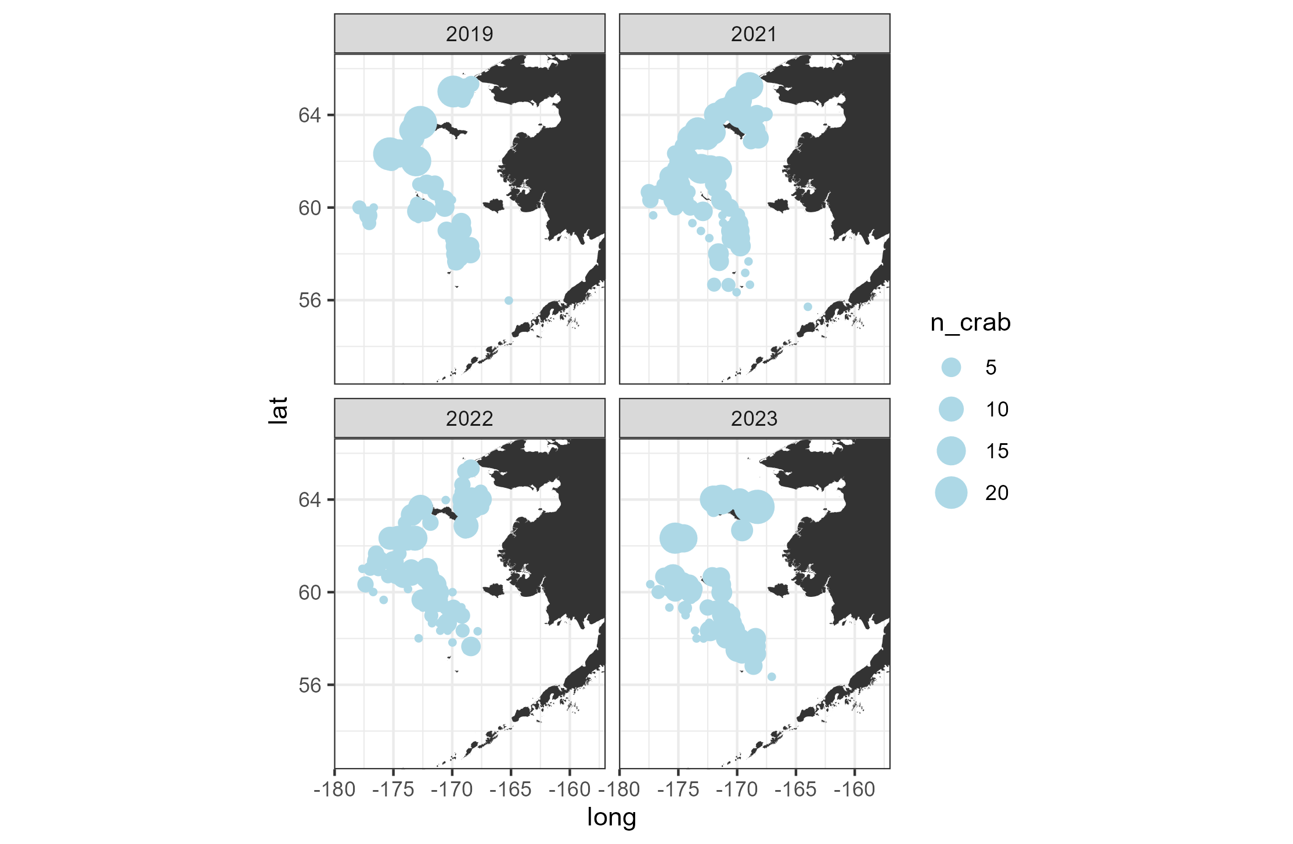

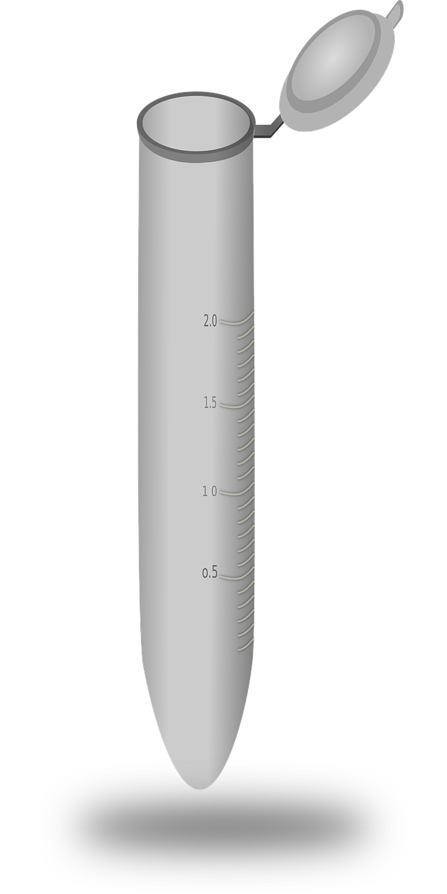

Development of a snow crab condition monitoring program
NBS
EBS
Annual hepatopancreas sampling conducted on NOAA Bering Sea bottom trawl survey to:
Monitor energetic condition and report as an annual indicator update in the Snow Crab ESP
Spatiotemporal modeling efforts to better resolve drivers of energetic condition
Mid-collapse
Post-collapse
Station-specific environmental
variables
Individual-level biometrics
Random sample targeting pre-terminal molt snow crab
Post-collapse
Post-collapse
Individual-level hepatopancreas samples
Notes:
In 2019 we began at-sea collections for hepatopancreas, which is the primary organ for nutrient and energy storage in crab. These collections gave us samples both during to the collapse in 2019, and 3 years post collapse. Samples were also collected in both the eastern and Northern bering sea, which is important because while the NBS is dominated by juvenile snow crab, we didn’t see the same magnitude of declines as we did in the EBS.

Slide 5
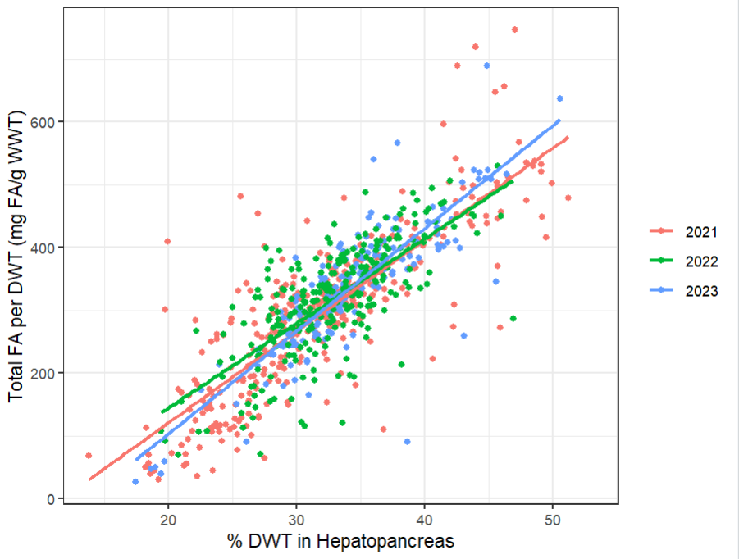
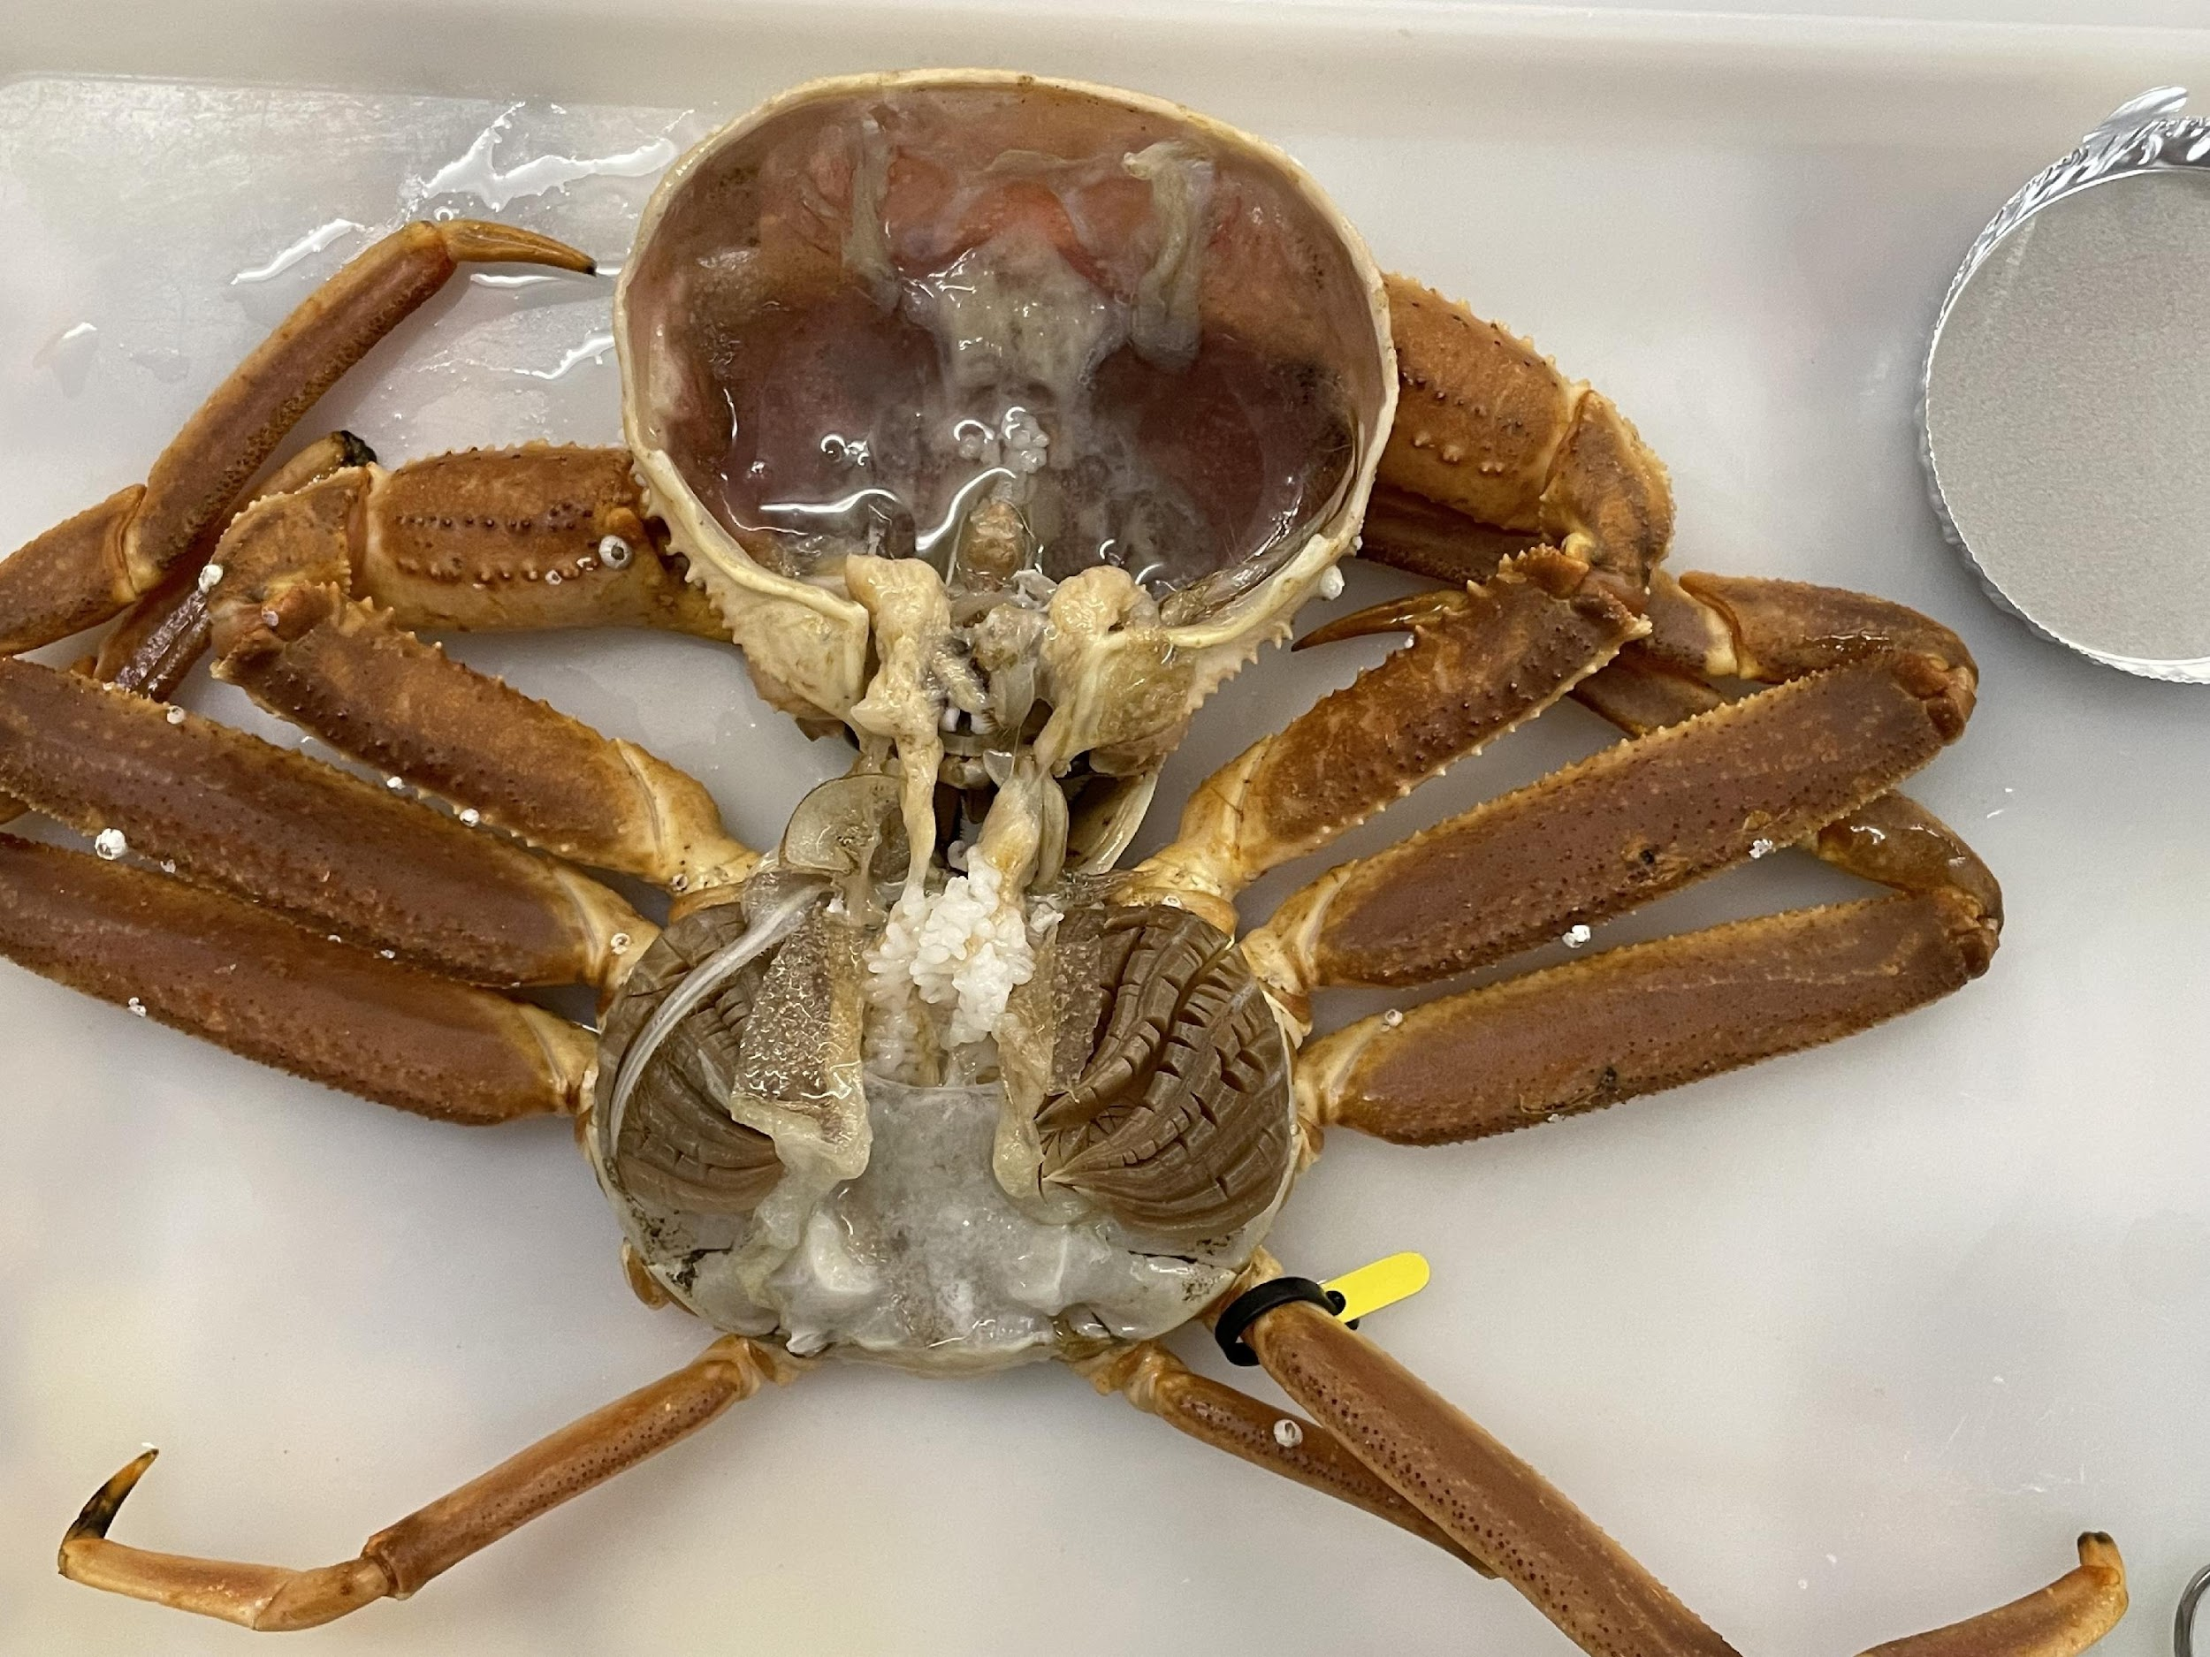
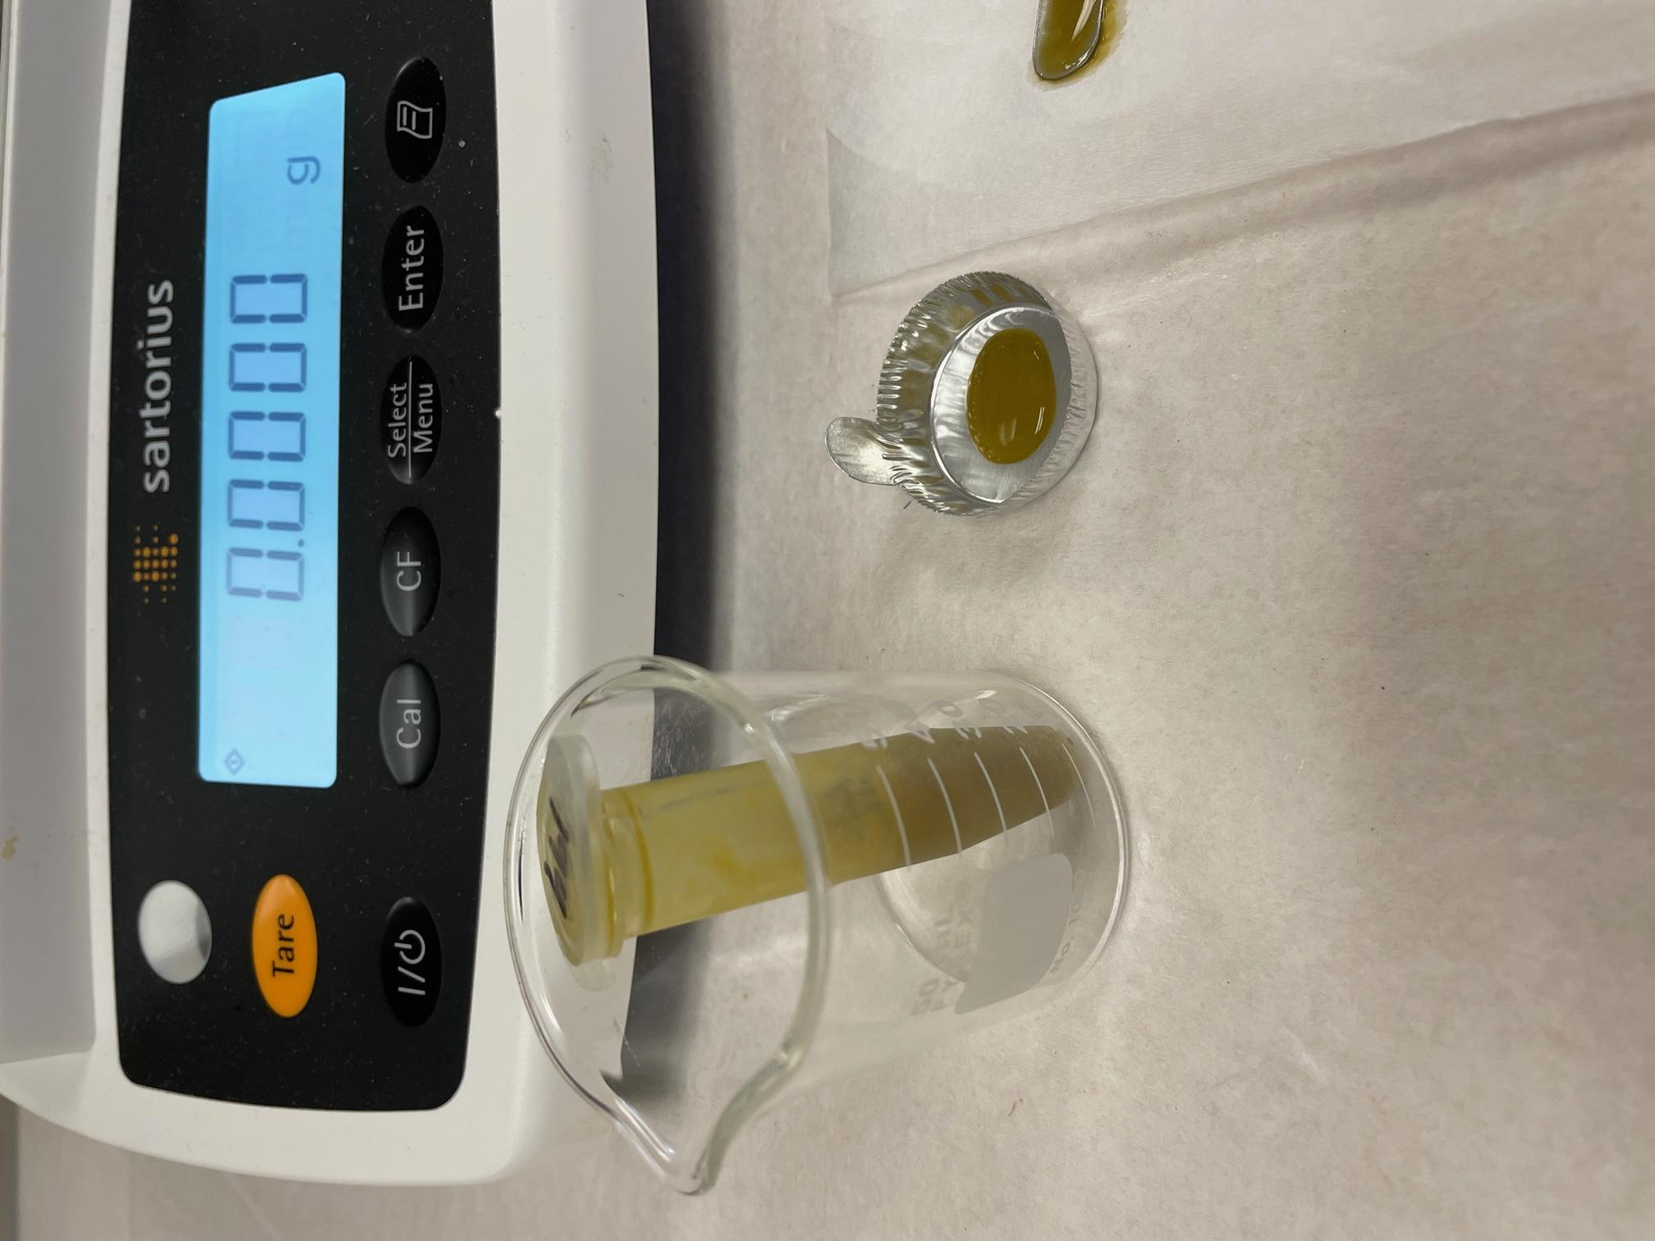
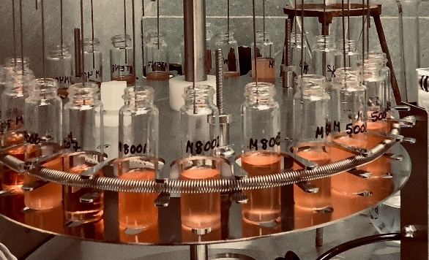
1. Validation of a rapid condition metric
Results indicate a strong linear relationship between water content of the hepatopancreas (% dry weight) and total fatty acids
Wet weight to dry weight ratios
Chemical extraction and derivitization of lipids
Integration of fatty acid methyl esters
Notes:
Once hepatopancreas samples were brought back to the lab, they were dried to calculate wet weight to dry weight ratios. We also used hepatopancreas samples for fatty acid analyses.
The figure at the right indicates a strong linear relationship between percent dry weight in the hepatopancreas and total fatty acids, suggesting that our rapid condition metric performes well.

Slide 6
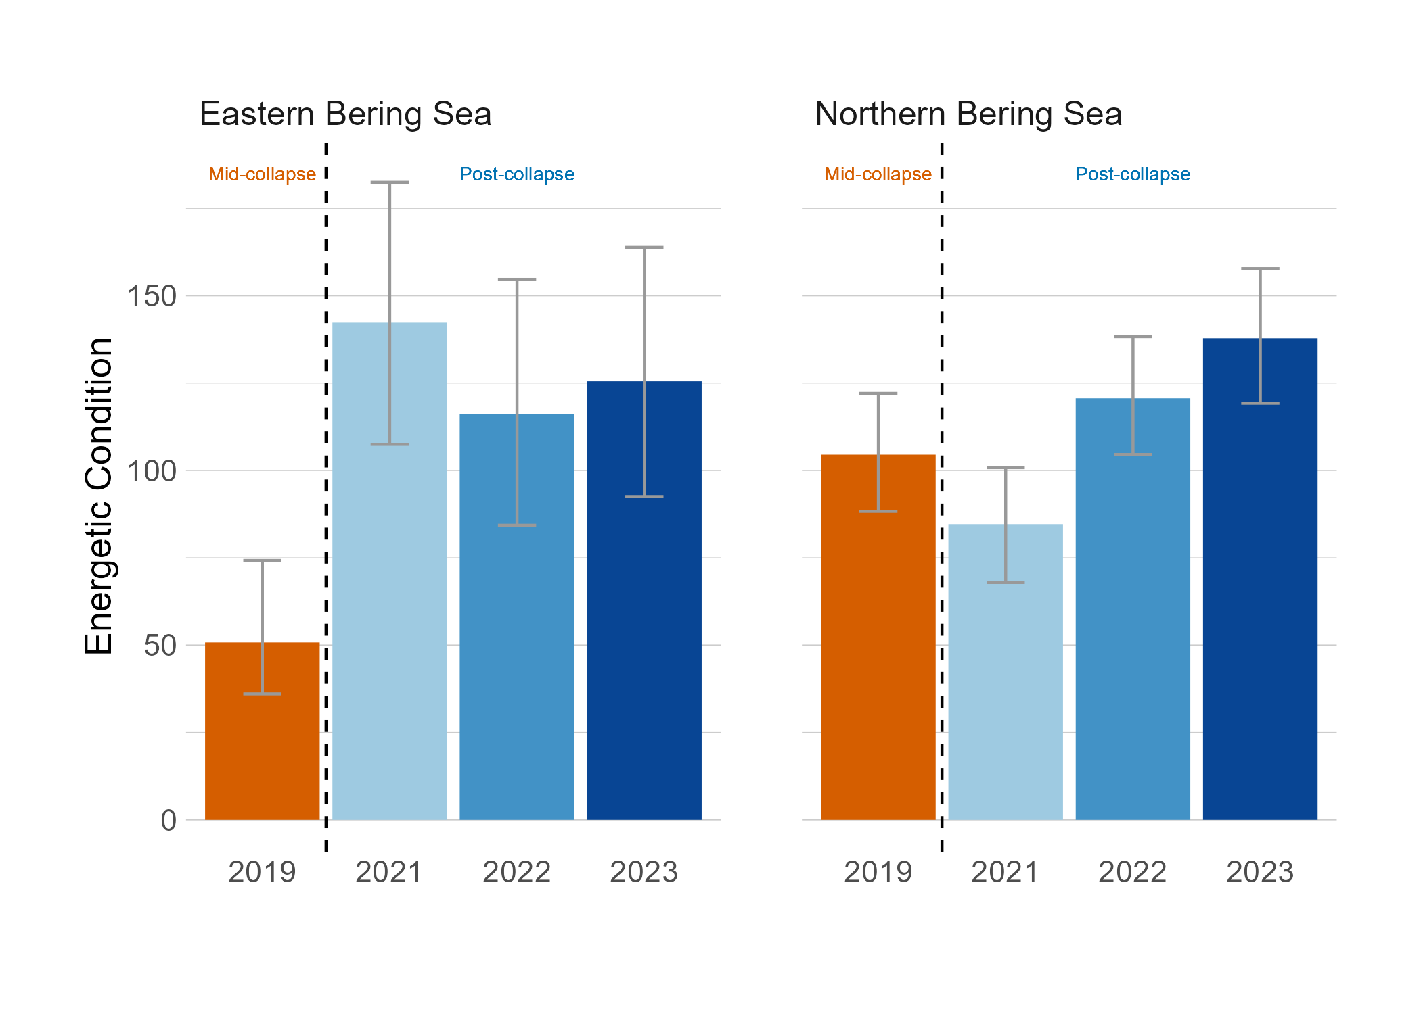
Energetic condition of snow crab during the eastern Bering sea population collapse (2019) was extremely low
Notes:
Results indicate that in 2019, during the eastern Bering Sea collapse, energetic condition of snow crab was very poor. We did not see the same dramatic reduction in energetic condition in the NBS in 2019.
Energetic condition post collapse increased, possibly indicative of stock recovery and rebuilding given that we’ve seen new recruitment in recent years

Slide 7
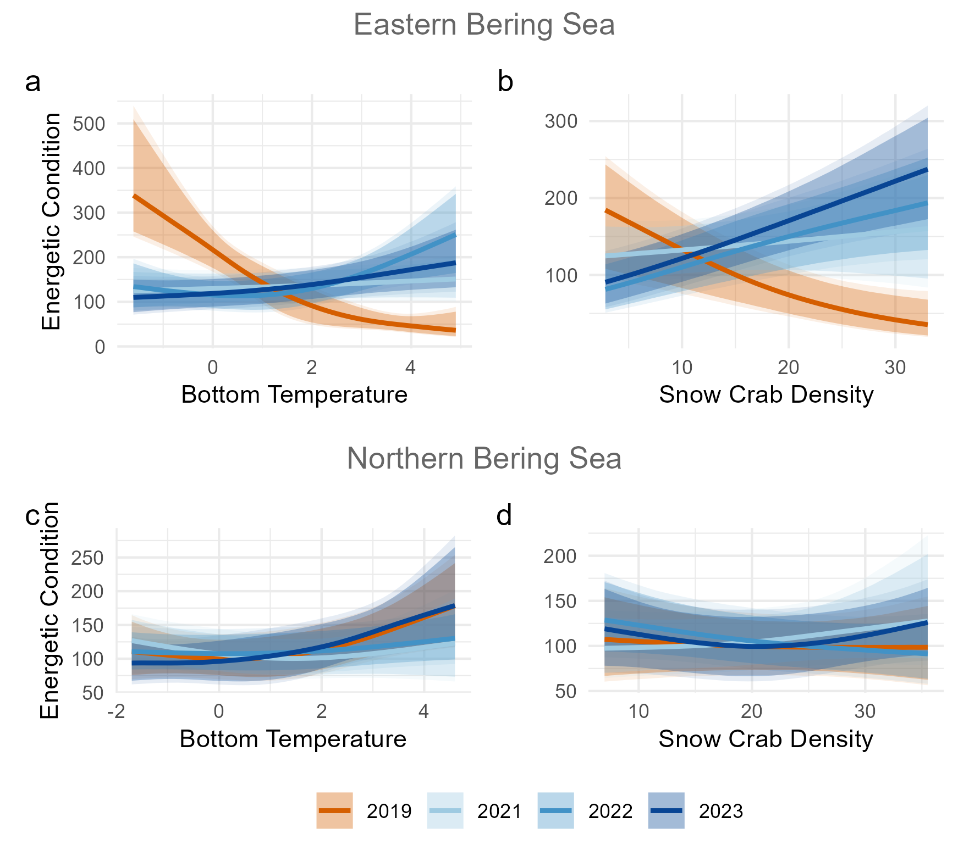
Strong differences in the direction and magnitude of temperature and snow crab density effects on EBS energetic condition within mid- and post-collapse years
Weakly positive temperature effects on energetic condition in the NBS
Notes:
Plots illustrate Bayesian regression modeling results in examining the relative importance of bottom temperatures and snow crab density on energetic condition.
There was a strong negative effect of temperature on energetic condition during the collapse, and weak positive temperature effects were evident in post-collapse years. Snow crab density effects show negative density-dependent effects on energetic condition during the collapse and positive effects of density post-collapse
NBS- positive temperature effects on energetic condition in 2019 and 2023, and no effect of density

Slide 8
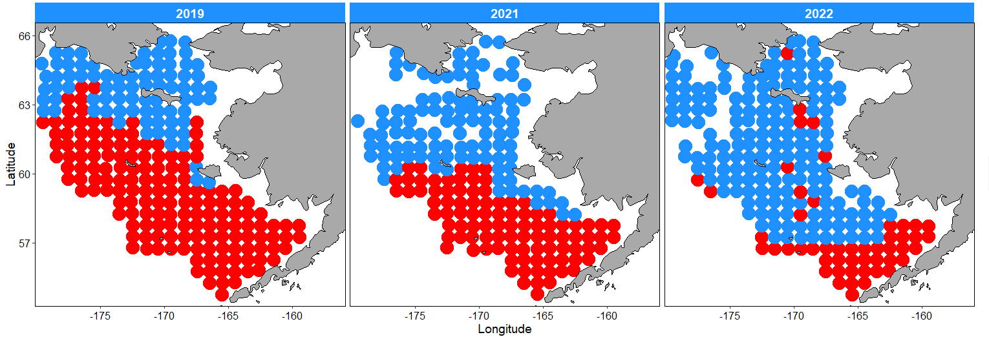
Question of the week: How are temperatures and sea ice regulating snow crab productivity?
*Spring bloom dynamics and benthic pelagic flux*
Ice-associated bloom
Open water bloom
Nielsen et al. 2023
Notes:
In interepreting temperature results – what’s the mechanism behind temperate effects on condition? This ties into a question that’s come up repeadidly Mon/Tue, asking about the rxn b/w sea ice and snow crab productivity
Here, Jens and collaborators have estimate spring bloom type (ice-associated, open-water) across the Bering Sea shelf. In warm years like 2019, open-water blooms are more widespread, and even occur in the Northern Bering Sea
Ice associated blooms = energy rich ice associated diatoms – less secondary production means more of this reaches the benthos
Thinking of sea ice as proxy for food quality/benthic production, vrs thermal habitat preferences

Slide 9
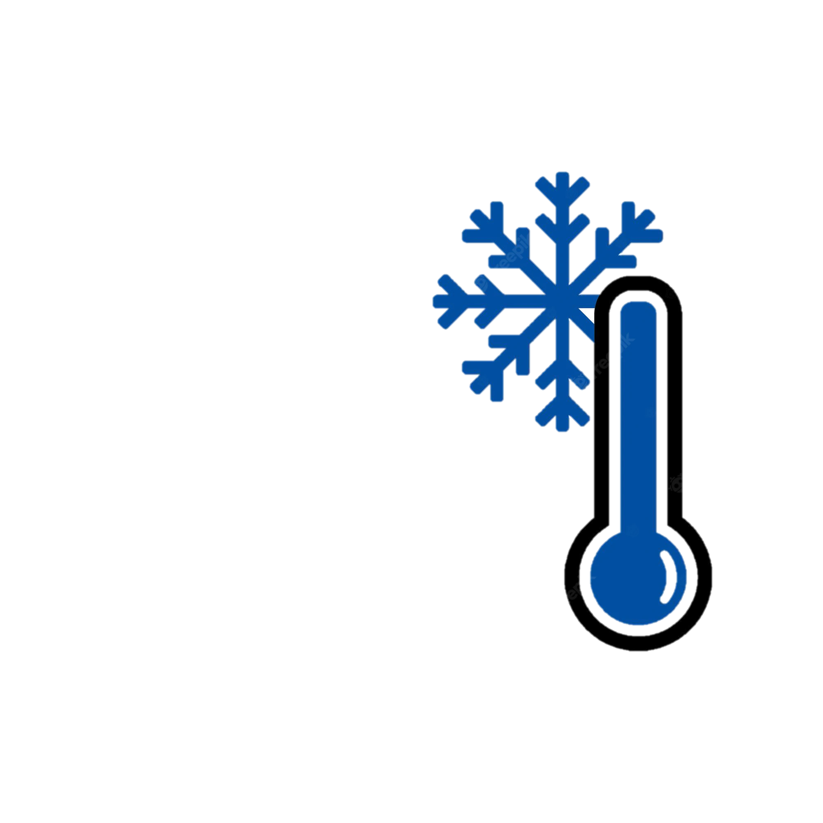
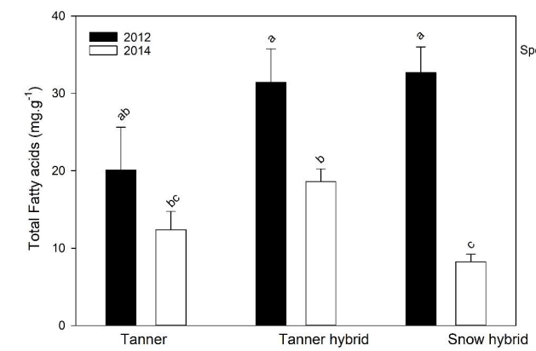
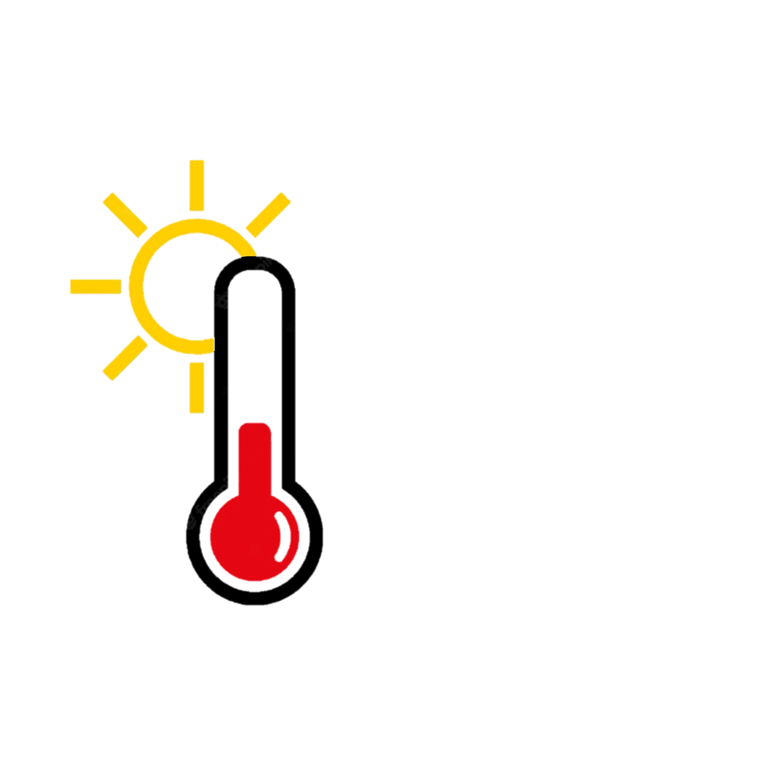
Why do diatoms matter?
During cold years, energy storage of diatom-sourced fatty acids points to the potential importance of diatoms to snow crab energetic condition
Copeman et al. 2021

Slide 10
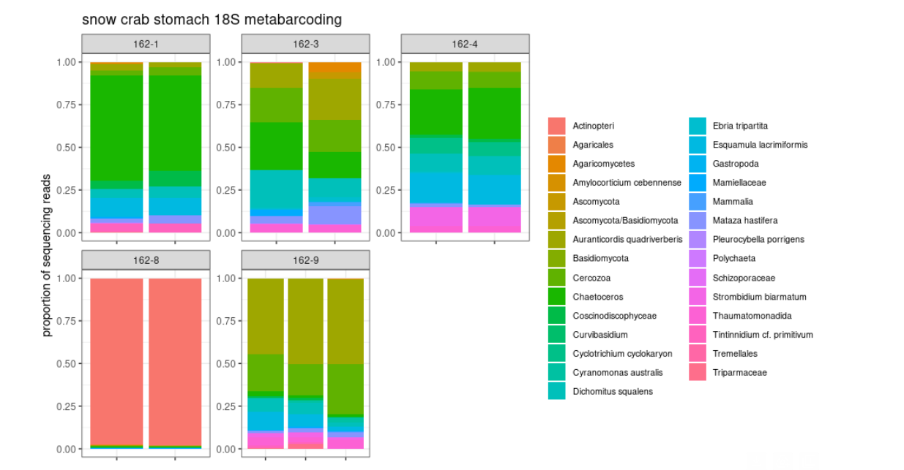
Why do diatoms matter?
Diatoms appear to be directly ingested by juvenile snow crab, likely attributed to a “benthic fluff” layer associated with carbon deposition to the benthos
Notes:
Very preliminary results from DNA metabarcoding of snow crab gut contents

Slide 11
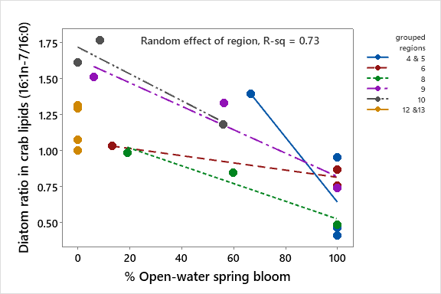
Can we relate bloom type to diatom-derived fatty acid biomarkers?
Overall, open-water spring bloom conditions were associated with a reduction in diatom-sourced lipid storage of juvenile snow crab
Notes:
Bigger picture, a reduction in the occurrence of ice-edge blooms may negatively impacted juvenile crab nutritional condition.

Slide 12

Ice edge bloom
Warming and reduced
sea ice can impact survival of juvenile snow crab
Open water bloom
Energy-rich, ice-associated diatom production
Energy-poor, small phytoplankton production
Diatom flux to benthos
Zooplankton grazing
Enhanced juvenile snow crab condition
Reduced juvenile snow crab condition
Notes:
Illustrated here is the indirect effect of temperature on the quantity and quality of food resources fluxing to the benthos. With a shift to a warm regime, sea ice retreats early and the bloom is delayed in thermally stratified waters. Under these conditions, most production remains in the water column and the bloom does not fall to the seafloor. Open-water bloom also tend to favor energy poor, small species of zooplankton and phytoplankton. Long-term shifts toward warmer conditions may shift energy and food resources available for benthic snow crab
So big picture: Absence of ice-edge blooms results in smaller phytoplankton size and reduced flux to the benthos. Leads to reduced benthic food quality and declines in juvenile snow crab condition

Slide 14
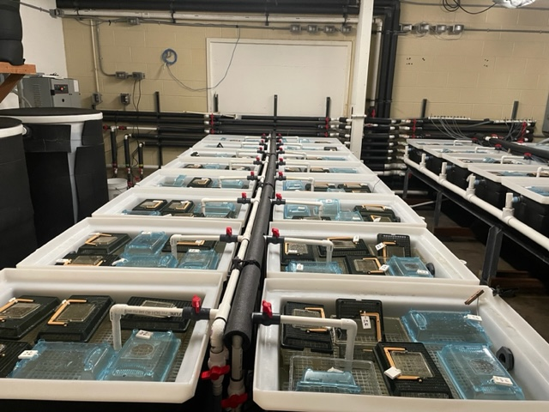
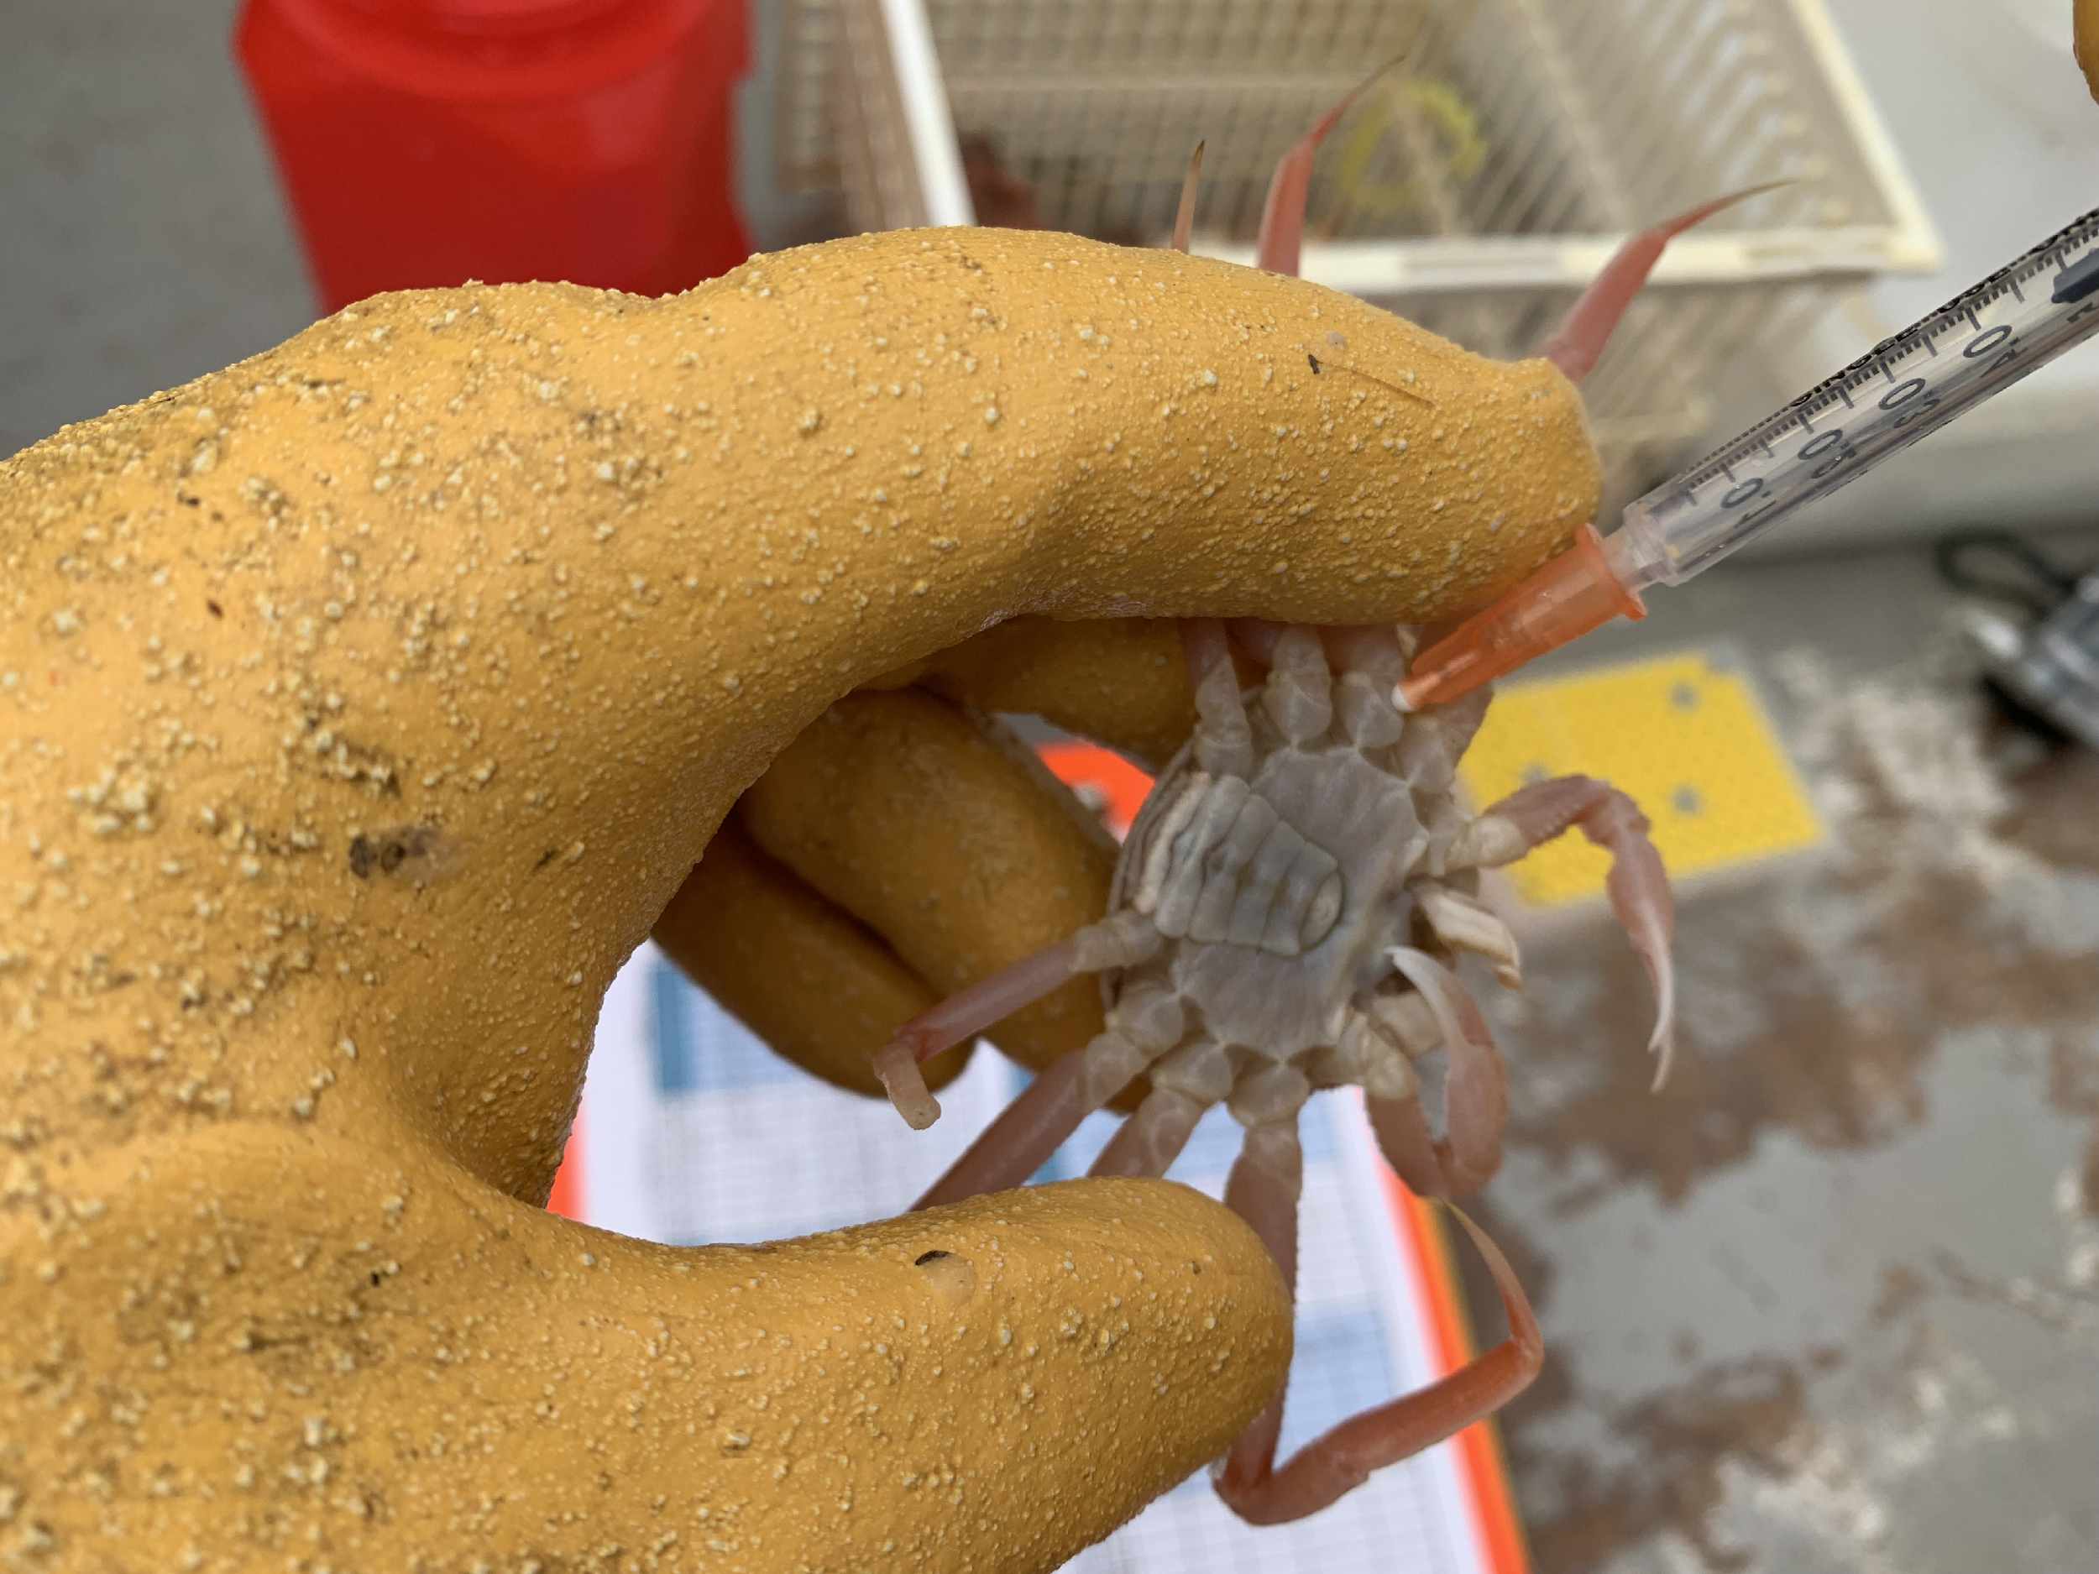
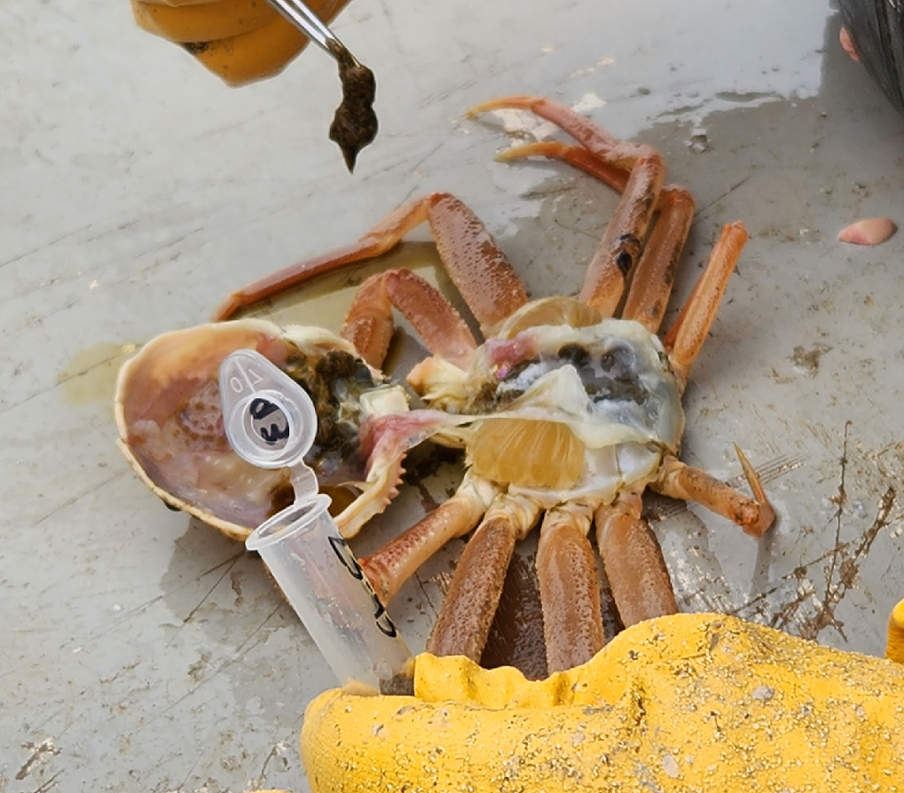
Laboratory studies to ground truth field-collected data
Starvation study in progress (Newport, Oregon)
2°C, 5°C and 8°C treatments
Responses: Condition, survival, body weight, hemolymph (Brix index)
Laboratory validation of a non-lethal condition metric: The Brix Index
Metabolic scope (planned for 2024)
Food ration and temperature treatments
Responses: Respiration, condition
Notes:
In response to the starvation hypothesis I presented earlier, are field-collected measures of condition consistent with crab starved in the laboratory?
Discrepancy b/w realized and thermal niche – snow crab can survive at warm temps, and withstand long periods of starvation in the lab

Slide 15

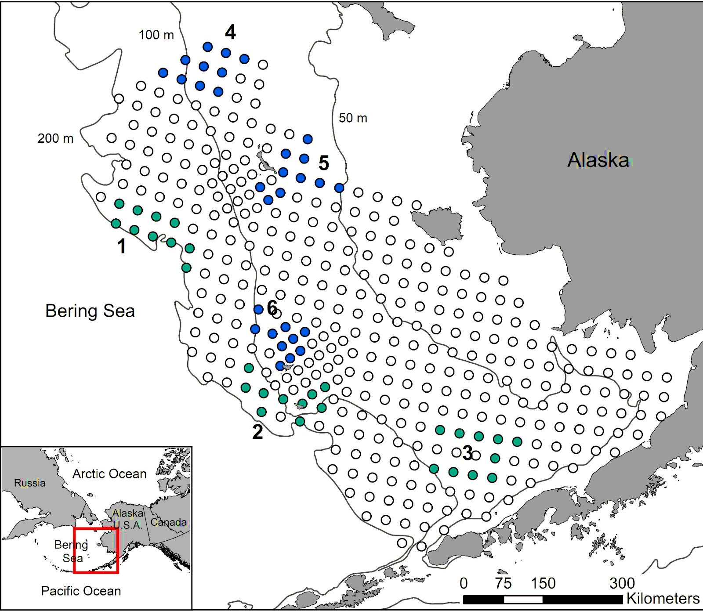
Bitter crab disease monitoring
Three snow crab monitoring sites within the EBS bottom trawl survey grid to:
Maintain spatiotemporal consistency in disease detection across years
Sample a representative portion of each population
Tanner Site
Station-specific environmental
variables
Snow Site
Individual-level size measurements and visual diagnosis
Random sample
within index site
Individual-level hemolymph samples for PCR diagnosis
Notes:
In 2014, six Tanner and snow crab monitoring sites were developed in the eastern Bering Sea to begin the first monitoring program for bitter crab disease using PCR diagnostic methods. The sites have been sampled annually on the EBS BT survey to maintain spatiotemporal consistency in disease detection across years. At designated stations within each index site, up to 20 crab were randomly sampled for hemolypmh for PCR diagnoses. Sex, carapace width and visual diagnosis were also recorded for each crab sampled giving us dual diagnoses of each crab sampled. In addition, bottom temperature, depth and crab densities were measured at each station sampled.

Slide 16
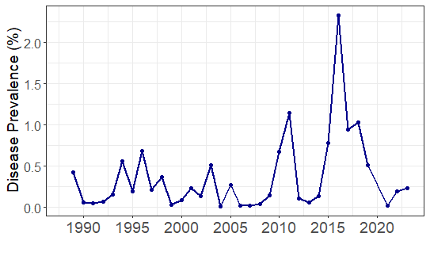

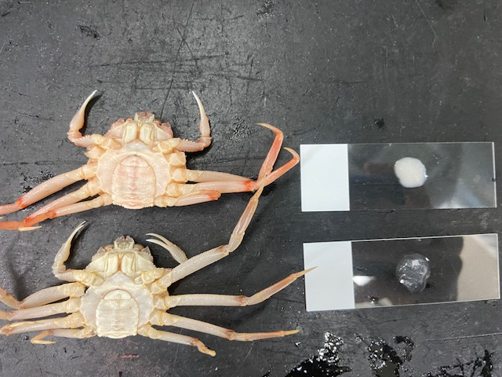
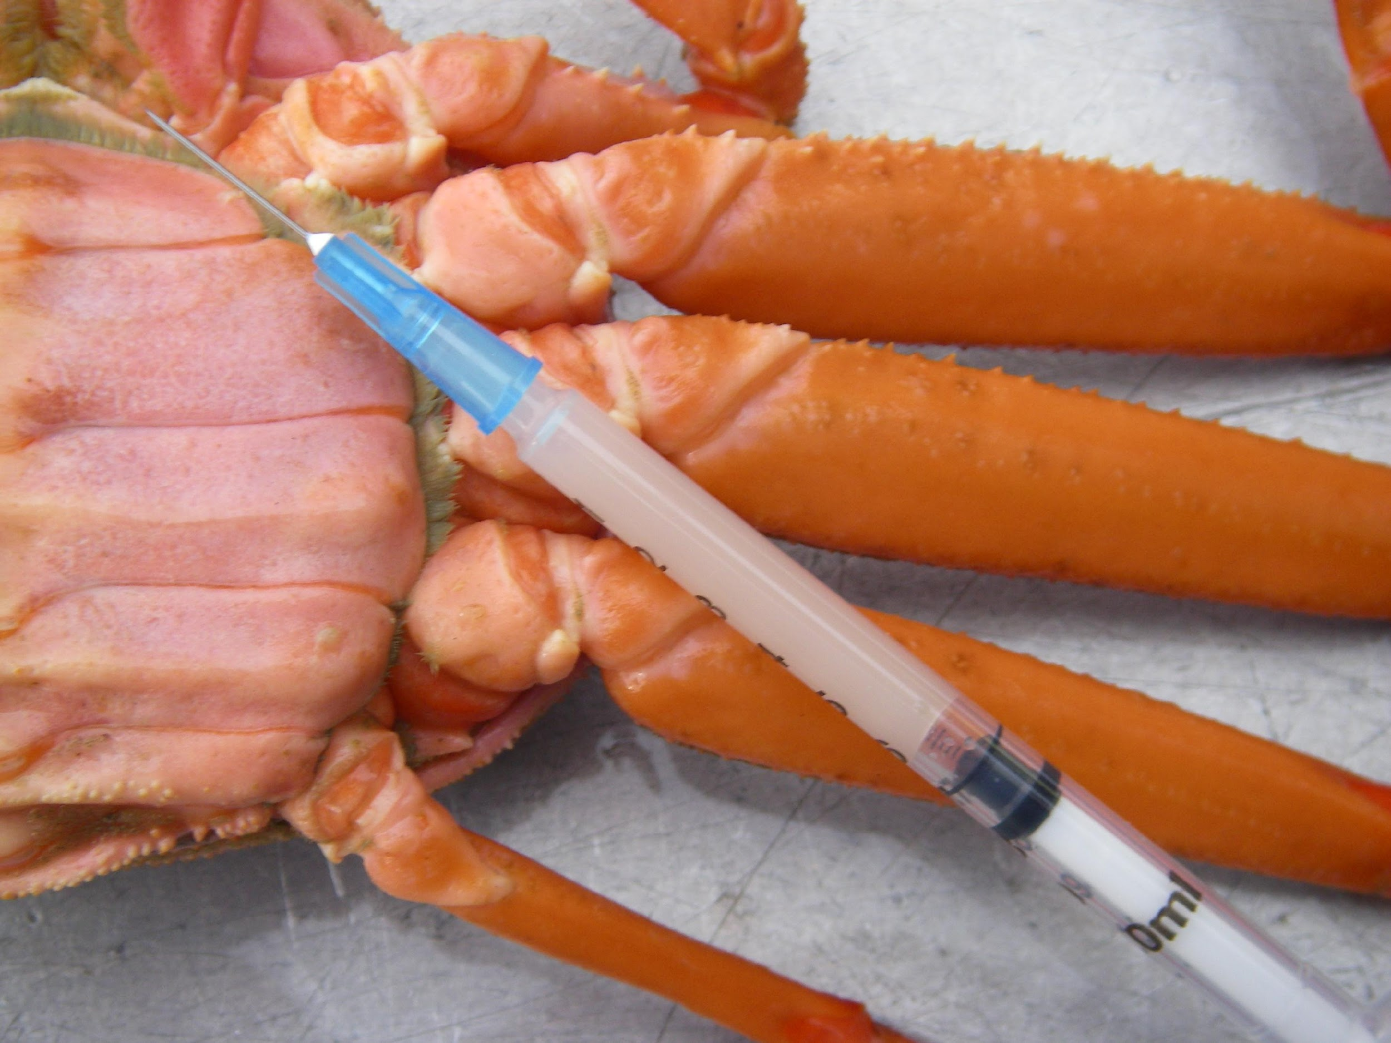
Detection of bitter crab disease infection
The average prevalence of bitter crab disease in snow crab diagnosed via visual symptoms is < 1%
Method #1: Visual Symptoms
Insensitive
Underestimates true population prevalence
Valuable long-term timeseries
Notes:
Two methods of diagnosis have primarily been used for bitter crab disease monitoring in the Bering Sea. Parasitized crab tend to have a redish-pink carapace color and white hemolymph which enables us to visually detect the disease during standard sampling on the NMFS bottom trawl survey. Given that visual symptoms are generally only present in advanced stage infections, the technique is insensitive for lower grade infections. Visual prevelances averaging <1% greatly underestimate true pop prev compared to a more sensitive technique.

Slide 17
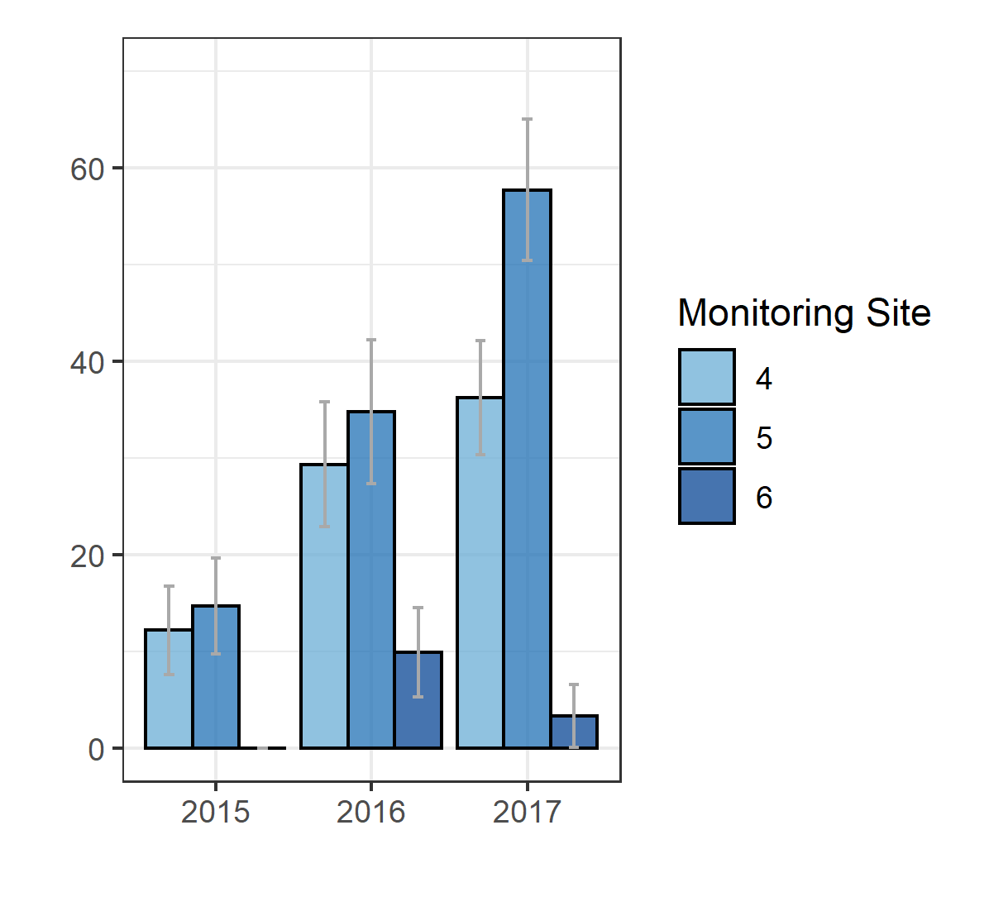

Detection of bitter crab disease infection
Molecular-detected prevalences ranged from 3.3% to 57.7%, and are dramatically higher than visual prevalences
Method #1: Visual Symptoms
Insensitive
Underestimates true population prevalence
Valuable long-term timeseries
Method #2: PCR assays
Diagnostic
Sensitive
Costly and time intensive
Notes:
Species specific PCR assays have also been developed to detect Hematodinium infections. Since these assays require at-sea hemolymph sampling and lab sample processing, only representative portions of the population can typically be monitored using PCR methods. However, PCR can definitively diagnose Hematodinium infections, and is much more sensitive than visual methods.
**NBS prevelances nearly 70% in 2017
**Mention Laurie paper – PCR dataset is so short that it’s difficult to resolve drivers, but longer visual timeseries is important for this

Slide 18
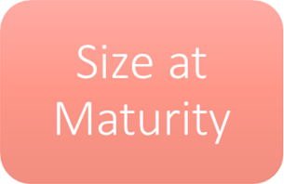
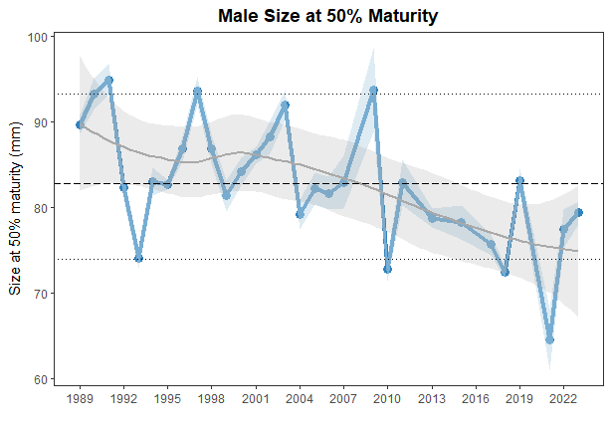
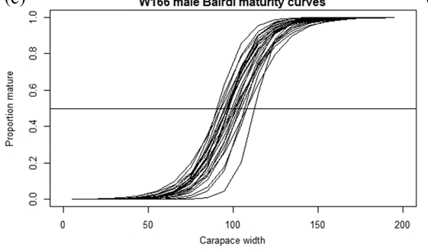
Annual size at 50% maturity in male snow crab has declined over time
Notes:
Left hand plot - observed probability of having undergone terminal molt
Two reasons to monitor:
Currency of management – if males are maturing at smaller sizes, it puts more exploitation pressure on fewer large males
implications for reproductive potential
Downward trend in SAM could signal that exploitation rates on large males are too high?

Slide 19
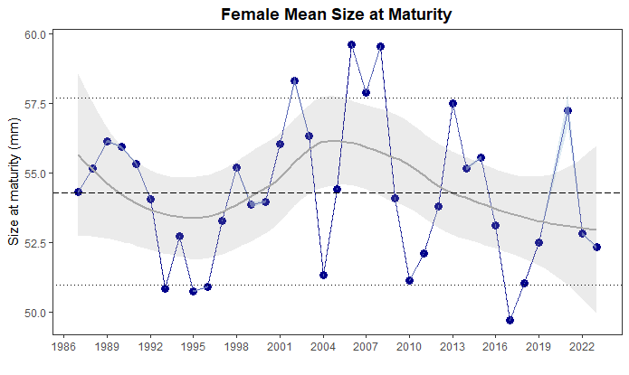
No directional trends in female mean size at maturity across the full survey timeseries

Slide 20

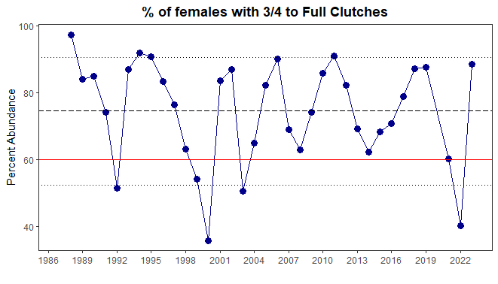
The percentage of mature females carrying ¾ to full clutches has reached concerning levels following declines in MMB
1999 Stock declared overfished
2021 population collapse
Notes:
Meant to capture signal of insufficient densities of large males for mating

Slide 21
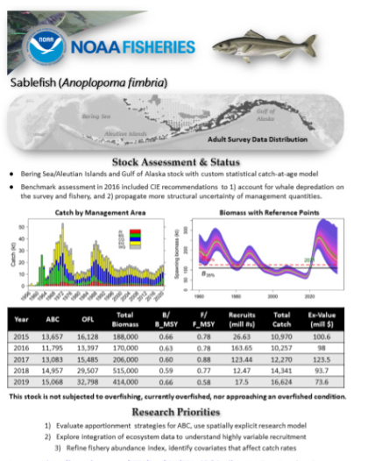

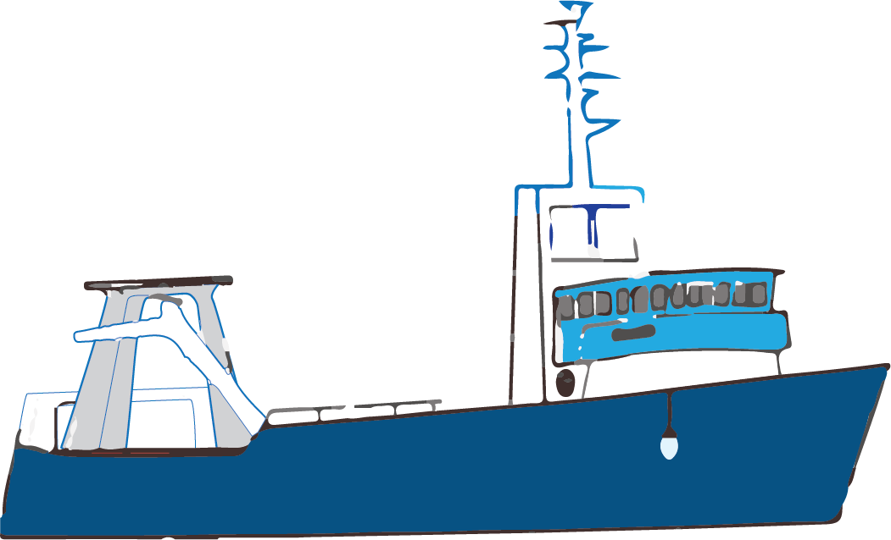
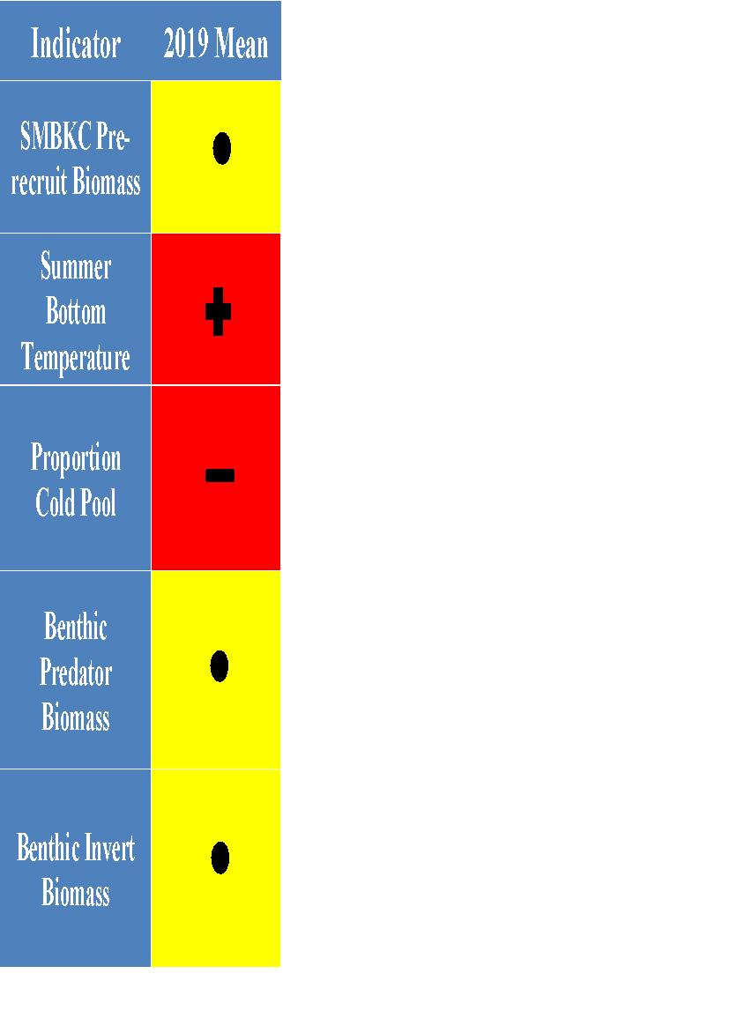
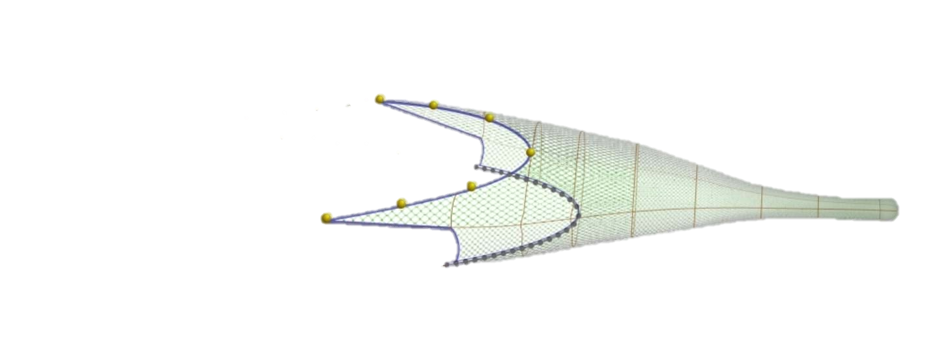

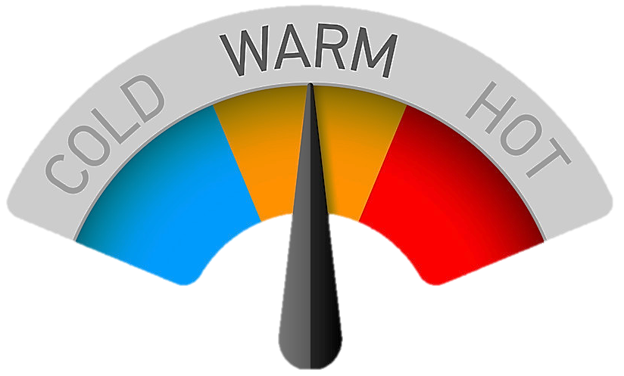
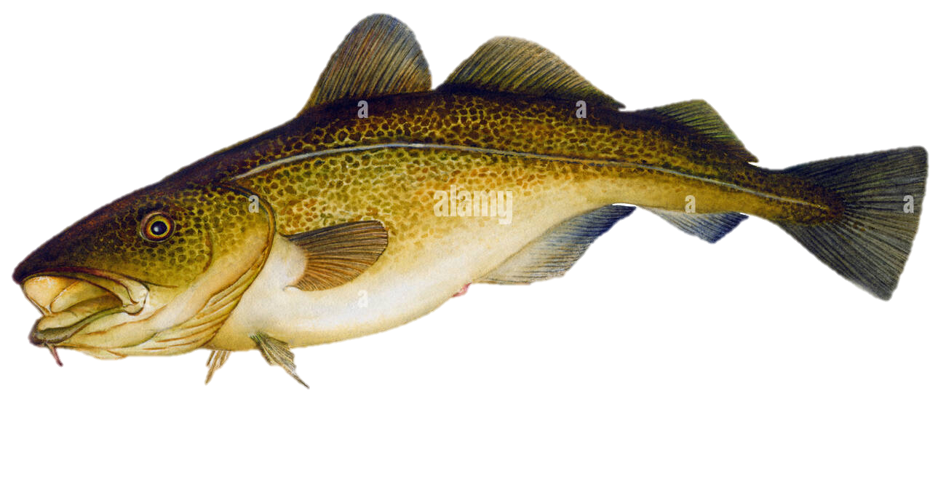
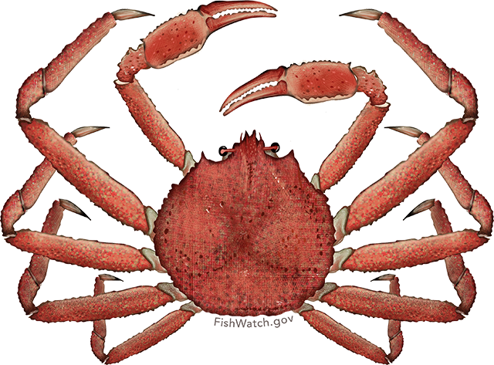
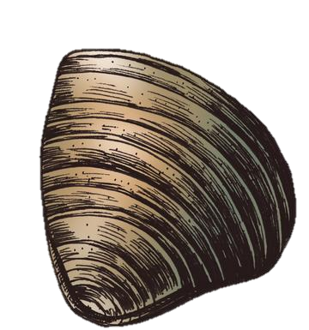
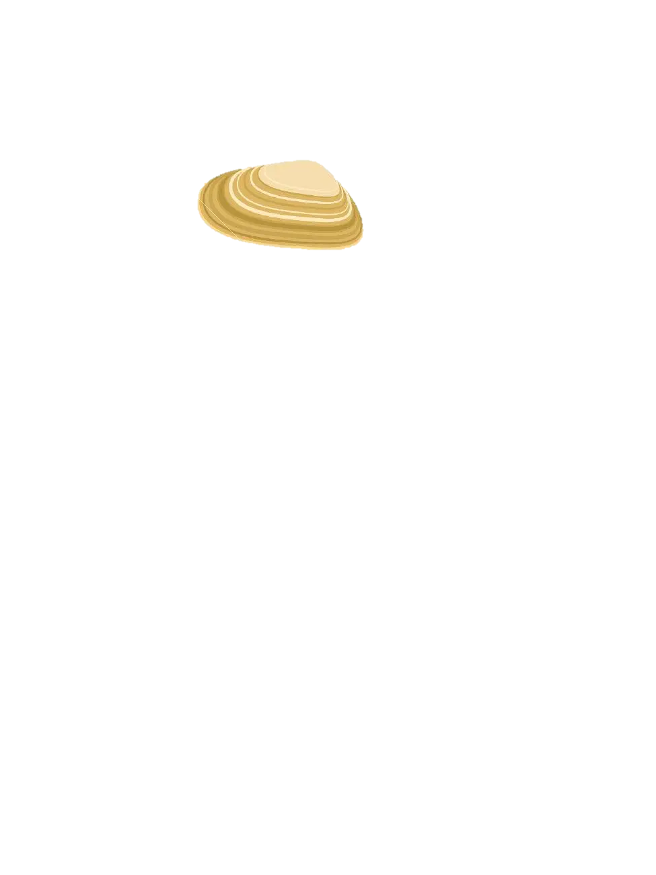
The Ecosystem and Socioeconomic Profile facilitates the integration of health indictors within the stock assessment process, and provides a tool to communicate current year trends to fishery managers
1) FOCUS
Prioritize and identify stocks for ESP
4) COMMUNICATE
Report indicator status and trends to decision makers
ESP process
2) SYNTHESIZE
Identify stock vulnerabilities and ecosystem pressures
3) ANALYZE
Create and monitor a suite of stock-specific indicators
Shotwell et al., 2023

